Slide 1



Sales Training
Corey Huetter, CEO
5-14-2024
Corey Huetter, CEO & Founder
Your Presenter
Thank You For Your Time
Notes:
Hi, welcome to Grow Restaurant Profits Restaurant Rescue presentation of Americas First and ONLY Restaurant Dining App paying restaurants huge monthly commissions while addressing most every challenge and pillar of success a restaurant faces. My name is Corey, the CEO and Founder of everything that will be to follow and I want to thank you for the opportunity to not only help your restaurant continue to survive…but to, more importantly, start to thrive to levels not possible without my GRP restaurant rescue platforms all over the country.

Slide 2
Americas’ Only Marketing Platform PAYING HUGE MONTHLY REVENUE SHARING COMMISSIONS TO RESTAURANTS WITH ZERO RISK
Corey Huetter, CEO & Founder
Your Presenter
Thank You For Your Time
Notes:
Hi, welcome to Grow Restaurant Profits Restaurant Rescue presentation of Americas First and ONLY Restaurant Dining App paying restaurants huge monthly commissions while addressing most every challenge and pillar of success a restaurant faces. My name is Corey, the CEO and Founder of everything that will be to follow and I want to thank you for the opportunity to not only help your restaurant continue to survive…but to, more importantly, start to thrive to levels not possible without my GRP restaurant rescue platforms all over the country.

Slide 3


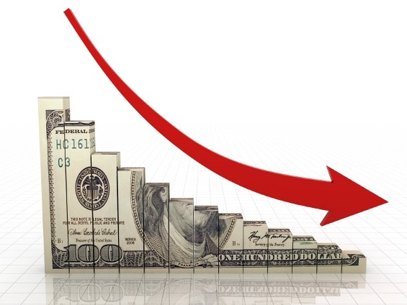











Notes:
What is to follow involves ZERO Cost to you today or ever. Absolutely zero risk and, more importantly, will greatly help you reduce stress, anxiety and fear about the long term viability of your restaurant in this ever challenging and uncertain economy. What is to follow truly is a literal restaurant rescue in the sense of all GRP offers restaurants while never asking them for a single penny.

Slide 4






Your Restaurant Has Been Invited To Be Part Of Your Restaurant Profit Group Dining Platform – Only 10% Of Sit-Down Restaurants Are Ever Allowed To Be Part Of Our Platform.
Notes:
If you are viewing this presentation please feel very fortunate and lucky as that means you restaurant was preselected out of 100s or 1000s of your competitors depending on the size of your market as only about 10 percent of sit down restaurants are allowed to be part of the GRP Restaurant Rescue in any market. So by the time we get to the end of this presentation, please apply right away as when I say you have nothing to lose….I mean you have zero to lose from a financial stand point but if you wait on the side lines and do not take one of the limited spaces when offered, there is a high probability your restaurant could be locked out for life which will have a negative impact on your restaurant sales for reasons you will discover shortly

Slide 5


Does Your Restaurant Qualify For The Your Restaurant Profit Group Dining Platform?
Notes:
Since all of the GRP Restaurant Rescue platforms are very limited for the number of restaurants we allow in the platform, I want to quickly cover the 7 key areas of frustration within your restaurant Grow Restaurant Profits Rescue Platforms are designed to address and significantly improve.

Slide 6





Q 1 of 7 Do You Have To Much Money In The Bank?
Notes:
1st question is do you have to much money in the bank? Seems like almost to stupid of a question to ask any business owner…but if you do…..then you can stop watching this presentation as what is to follow will surely be adding a LOT…and I mean a LOT….of cash directly to your bottom line….well not cash in the Ozark or breaking bad sense…but monthly commission deposits being transferred to you monthly that truly is the foundation to the GRP Restaurant Rescue

Slide 7
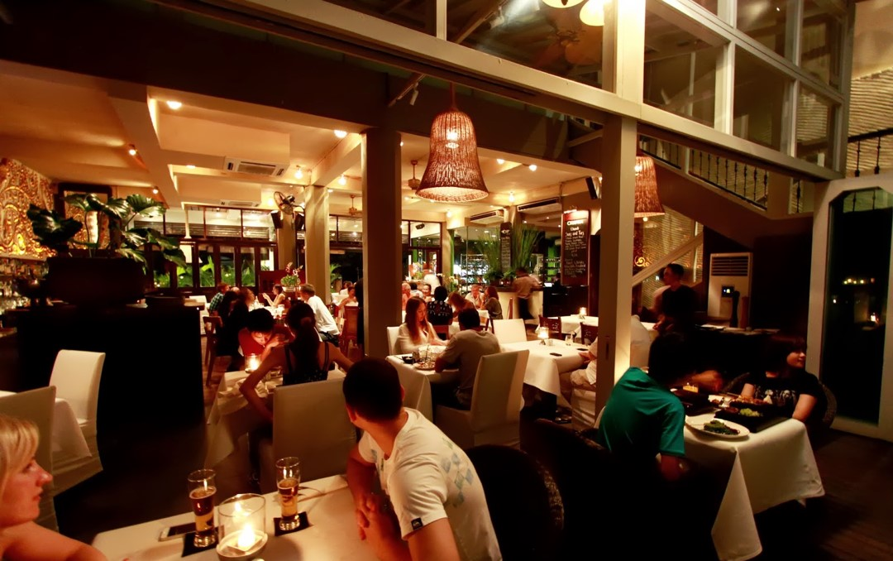
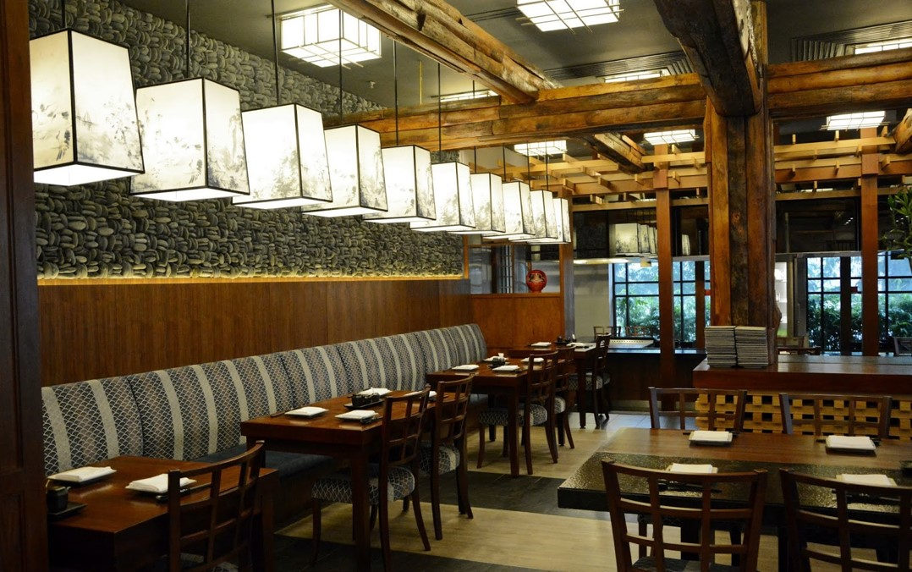


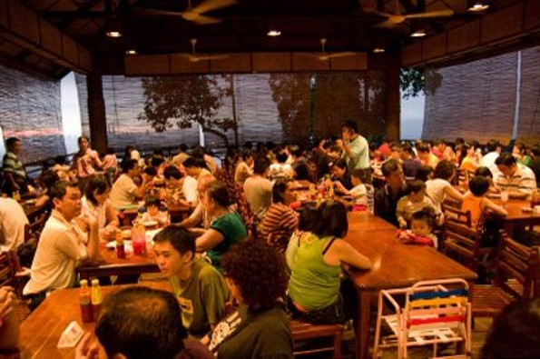
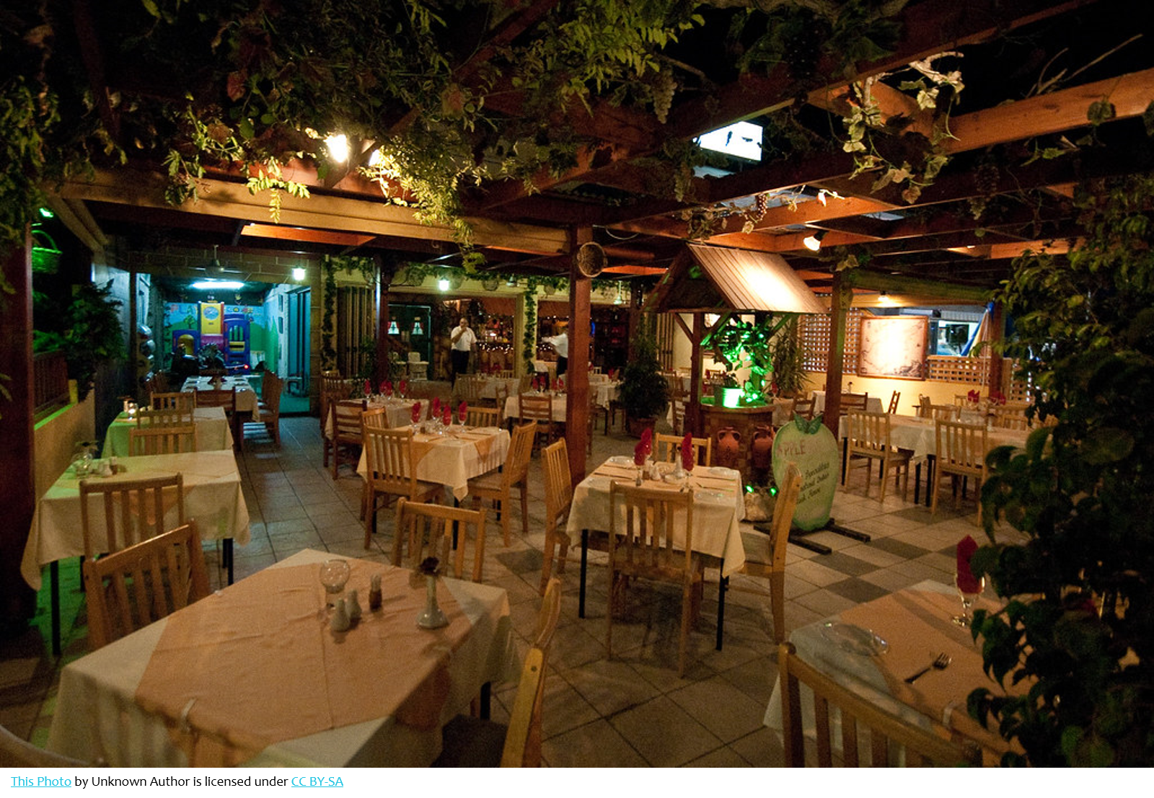

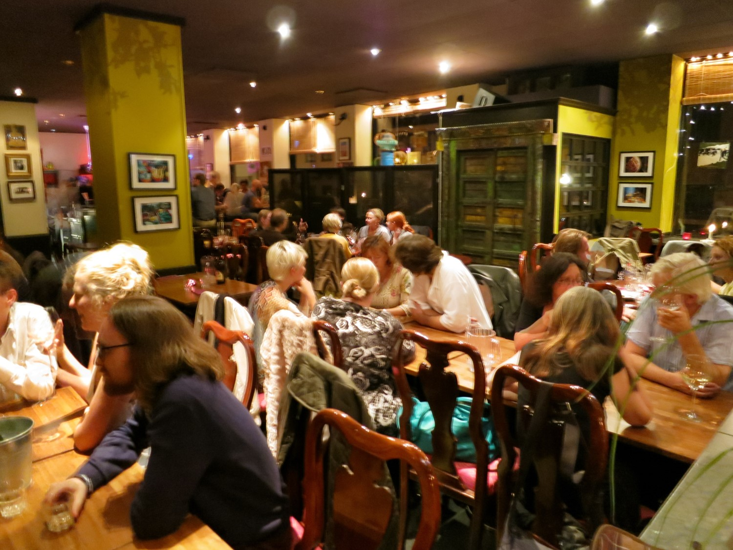
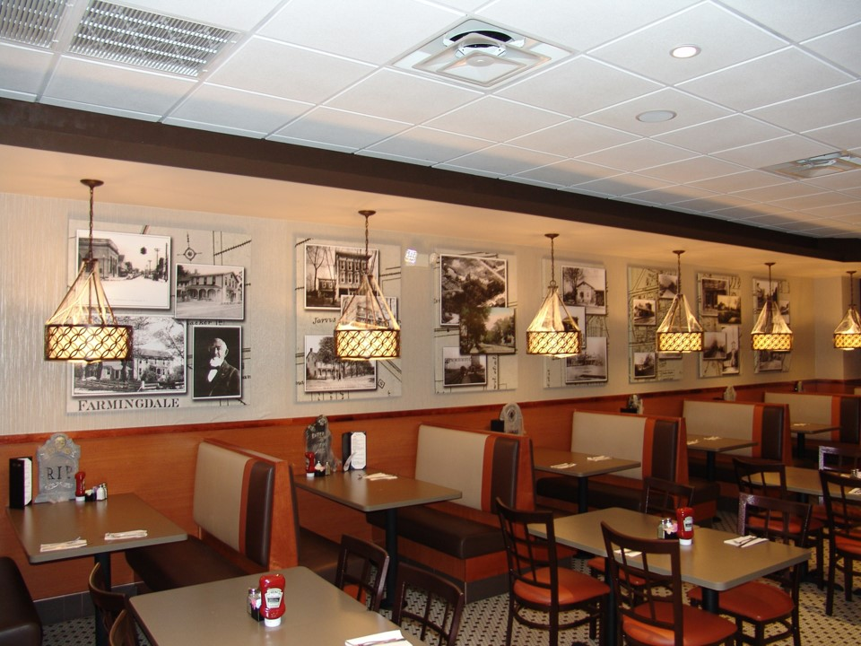

Q 2 of 7 Do You Have To Many Customers Coming In All Day, Every Day Minimizing Lost Due To Your Most Perishable Asset Any Restaurant Has Which Are Empty Seats?
Notes:
Question 2 – do you have to many customers coming in all day, every day minimizing lost due to your most perishable asset any restaurant has…and few owners realize the most costly perishable asset any restaurant has is empty seats as an empty seat on Monday can’t be made up on a Tuesday. A full seat regardless of the profit margin is always better than an empty one.

Slide 8





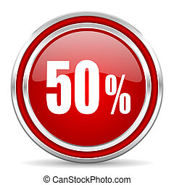
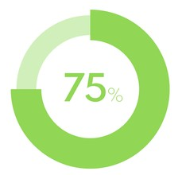

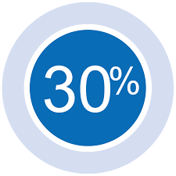

Redemption Cost
Q 3 of 7 Do You Like Paying 30% To 50% Commissions To Restaurant Delivery & Discount Apps That Make More Profit From An Order Than You Do?
Notes:
Question 3 – do you like paying 30% to 50% commissions to restaurant delivery and discount apps that make more profit from an order then you do? Let me first say all but one of the platforms listed above are incredible companies when it comes to increasing bottom-line profits for their clients and I highly recommend all of them. The only one in where there can be a net loss on a redemption is the Big G you all know as they market a gift certificate to your restaurant at 50% off and then keep 50% of that – in redemption cost terms, if the person with the gift certificate only spends the value of the gift card, the redemption cost is 75% in where a restaurant would be at a net loss just on the food cost.

Slide 9

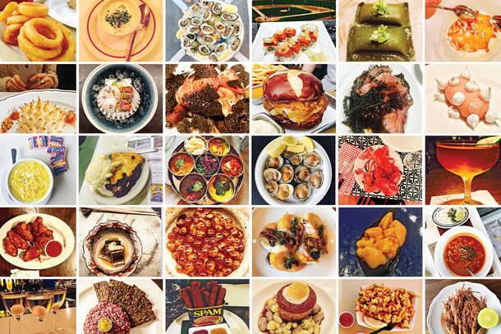






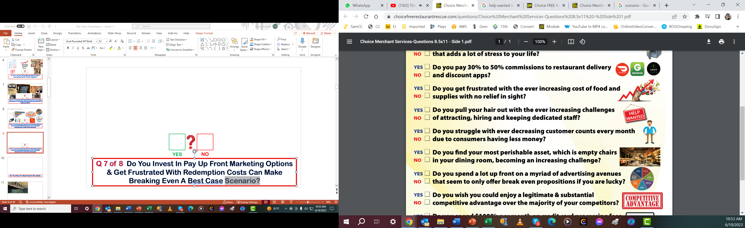




Q 4 of 7 Do You Like The Ever Increasing Cost Of Food & Restaurant Supplies?
Notes:
Question 4 – Do you like the ever increasing cost of food and restaurant supplies…..of course no owner of any business likes increasing input costs but seems restaurants are not only getting hammered with costs that have seen 100% increases in cost over short durations but availability of food and supplies has also been a new frustration added to owning and running a restaurant. How much has your food cost increased even inspite of raising menu prices that, in the end, will decrease customer counts and sales?

Slide 10
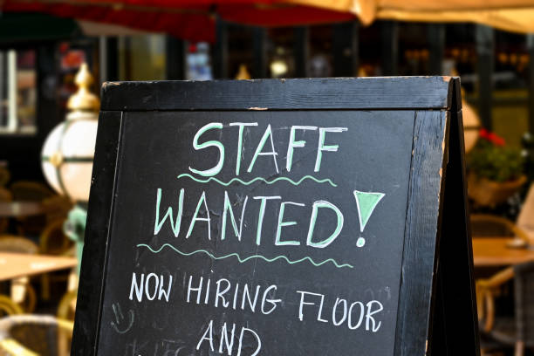




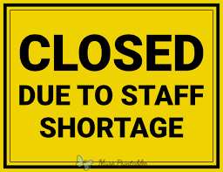
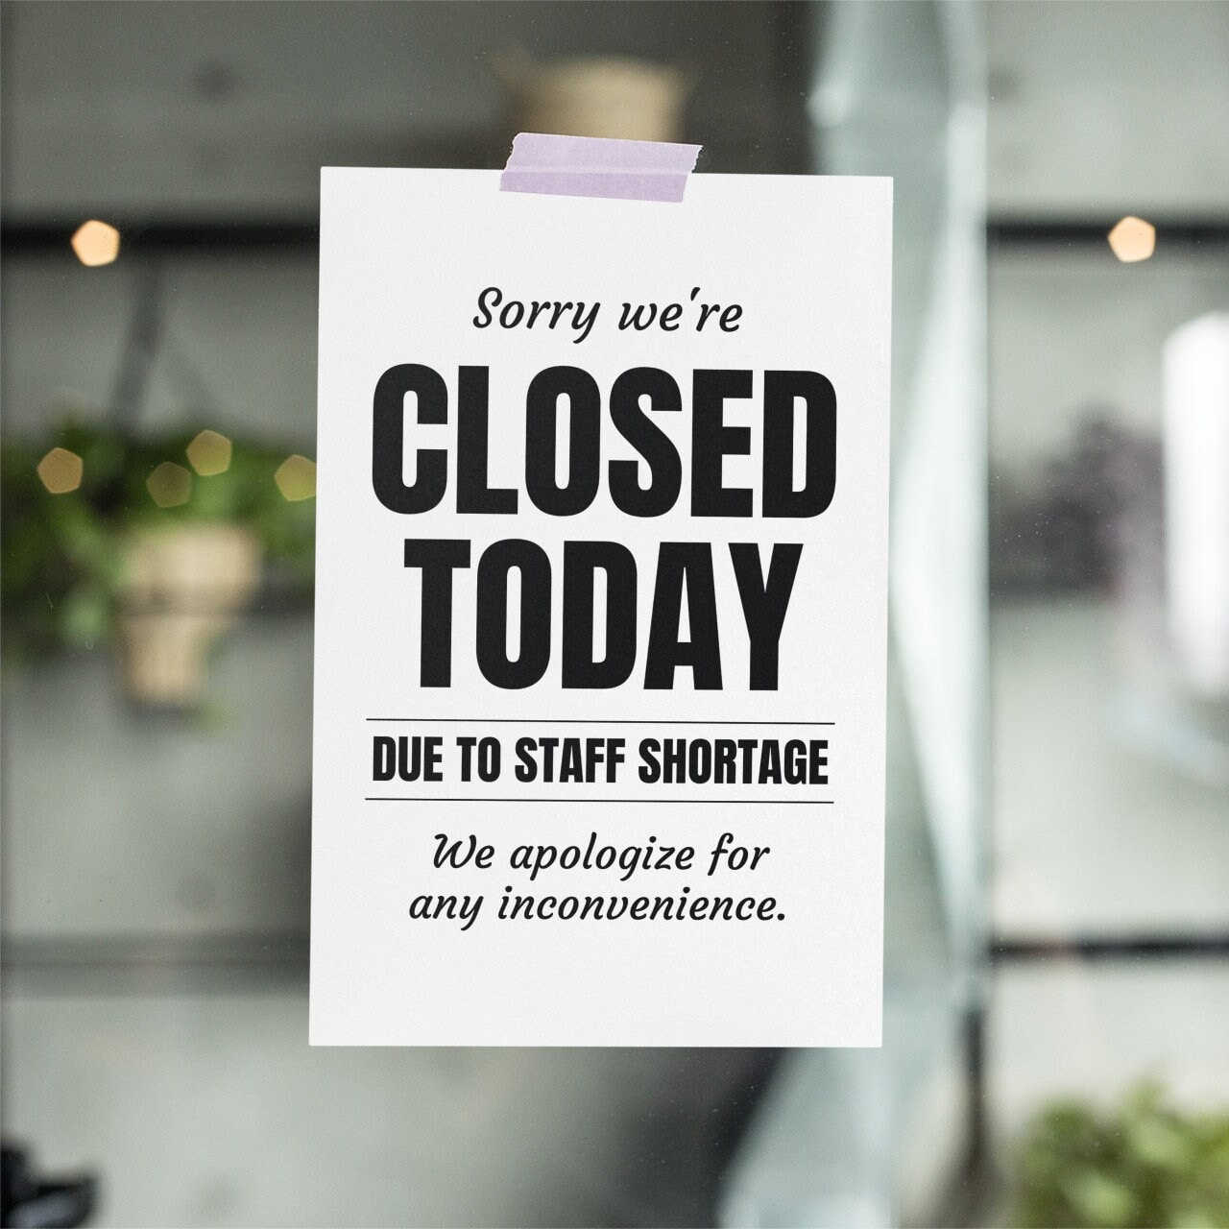
Q 5 of 7 Do You Like The Ever-Increasing Challenges Of Attracting, Hiring & Retaining Dedicated & Motivated Staff?
Notes:
Question 5 Do you like the ever increasing challenges of attracting, hiring and retaining dedicated and motivated staff? If you are in any major market, I am sure most watching will say H E double toothpicks to this new reality we live in where no one wants to work as they did even a decade ago and the ones who do want to work are at increasingly disappointing levels of intelligence and work ethic.

Slide 11


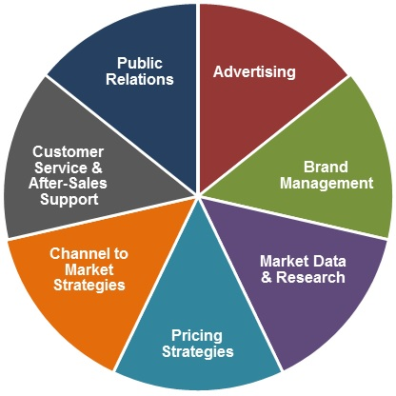
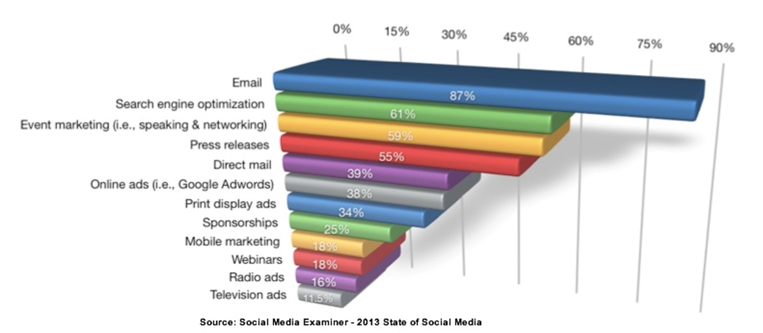





Q 6 of 7 Do You Like To Invest In Risky Pay Up Front Marketing Options & Get Frustrated With Extremely High Redemption Costs?
Notes:
Question 6 Do you like to invest in risky pay up from marketing options and get frustrated with extremely high redemption costs. I have owned a online printing company for 15 years and by the time a restaurant pays me for the design, printing and postage, many restaurants are lucky to break even and to get a decent response, most will run a BOGO to make for a very enticing offer creating even a higher redemption cost when combined with the up front costs already.

Slide 12
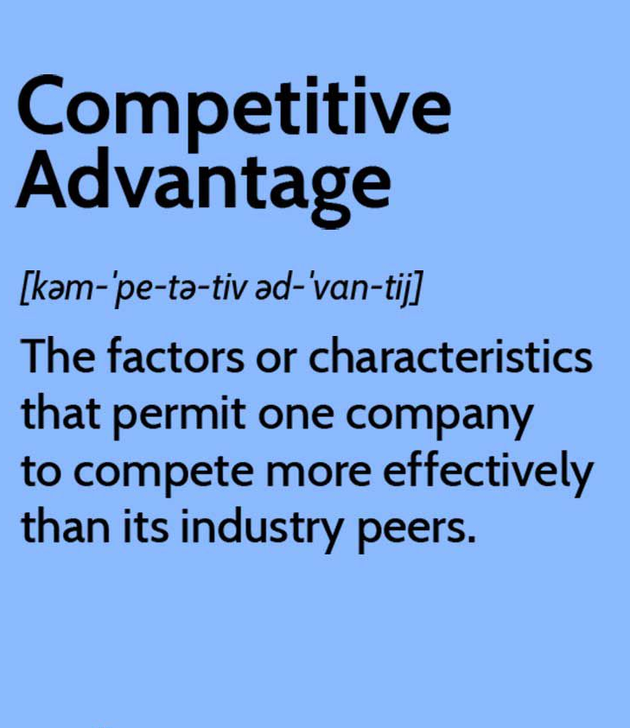
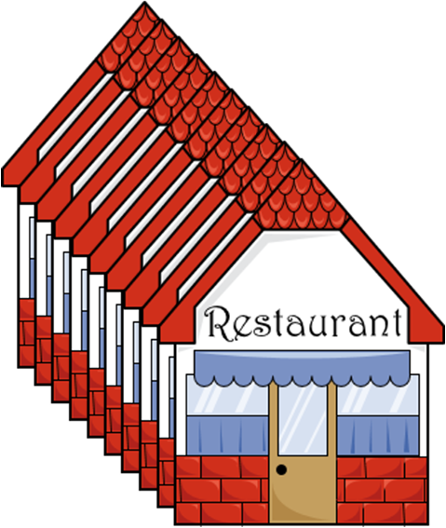


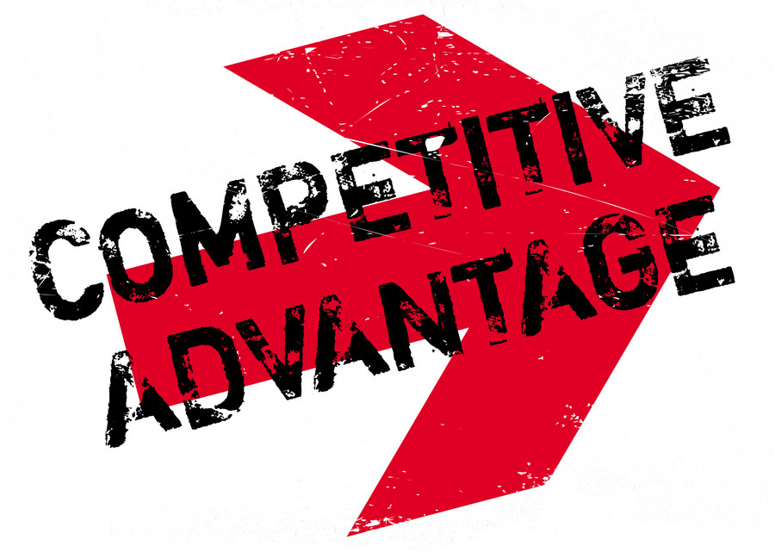




90% LOCKED OUT
Q 7 of 7 Do You Enjoy A True Competitive Advantage Over 90% Of Your Market That Leads To Substantial Increases In Bottom-Line Profits?
Notes:
The 7 and final question is do you currently enjoy a true competitive advantage over 90% of your market that is leading to substantial increases in bottom line profits? I am not familiar with any marketing method available to restaurants that is not available to 100% of their competitors. Imagine how much more business your restaurant would get if just delivery apps and anheiser busch only allowed 1 in 10 restaurants to be part of their platform or sell their products….obviously the HUGE competitive advantage you would enjoyh would be unmatched.

Slide 13






Cash Flow Issues SOLVED
Empty Perishable Dining Seats SOLVED
No Commission Restaurant App SOLVED
High Food Cost Killing Profits SOLVED
Incredible Staffing Challenges SOLVED
Pay Up Front Marketing Risky & Costly SOLVED
Huge Competitive Advantage Finally SOLVED
If You Answered NO To Most Or All Of These Questions Then You Are At The Right Place At The Right Time To Begin Addressing & Solving All Of These Challenges.
Notes:
Most restaurant owners will have answered NO to most all..if not all…of the questions I just presented and what is to follow will give you the ability to turn all those NOS into HUGE YESSES. I hope you are getting a little curious and excited for a platform that can make these kind of promises when no other in the past ever could come close.

Slide 14



As Mentioned Earlier, What Is To Follow Requires ZERO Money From You Today, Involves ZERO Risk & ZERO Changes With All Aspects Of Your Restaurant Operation.
Notes:
As I mentioned earlier, what is to follow requires ZERO Money from you Today or EVER, involves ZERO risk ….and ZERO changes with any and all aspects of your restaurant operation. The only risk to any restaurant is not being invited into our rescue platform and being locked out which will effect 90% of all restaurants in a given market.

Slide 15


Your Restaurant Profit Group Is Just Another Piece To Your Already Existing Marketing Puzzle That Will Quickly Become Your Most Lucrative Piece In Many Ways
Notes:
The GRP restaurant rescue is just another piece to your already existing marketing puzzle that will quickly become your most lucrative financial piece in many ways to be covered next.

Slide 16

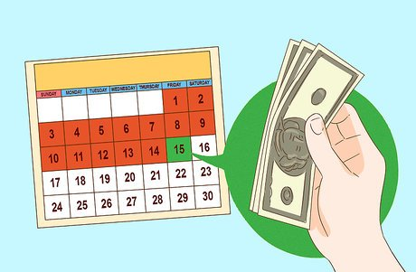
GET PAID
GET PAID MONTHLY
What Is The Core Driver Behind Your Restaurant Profit Group?
You Receive Ever Increasing Monthly Cash Revenue Sharing Commissions Every Month Without Having To Serve A Single Thing
Notes:
So what is the rescue aspect of GRPs restaurant rescues. You receive ever increasing monthly cash commissions every month without having to serve a single morsel of food or pay a single dollar in labor or food cost. This monthly cash commissions goes 100% down to the bottom line and adds generously to it to be illustrated in upcoming slides

Slide 17




Earn Monthly Cash Commissions While Accomplishing The 2 Biggest Goals For Any Restaurant: 1) Increase Ticket Averages 2) Increase Dining Frequency
Notes:
Not only does the GRP restaurant rescue pay huge monthly commissions that go directly to your bottom-line, this is all done while achieving the 2 biggest goals restaurantowners have which is increasing ticket averages and also dining frequency….

Slide 18

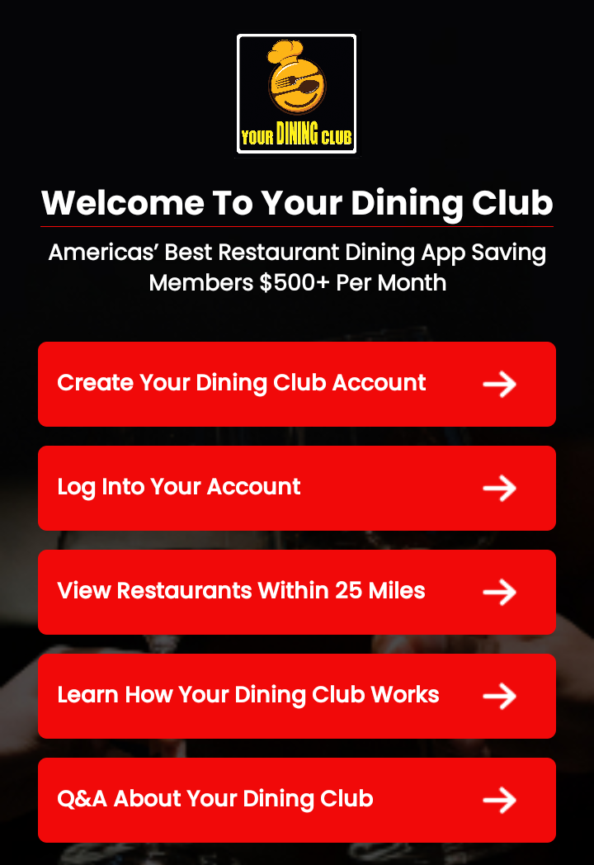



The Foundation To Your Restaurant Profit Group Is The Your Dining Club Restaurant Dining Platform Which Was
Created By The Top Restaurant Minds In America.
Notes:
The foundation to GRPs Restaurant Rescues all over the country is the BOGOMazing Restaurant Dining App which was created by the top restaurant minds in america

Slide 19
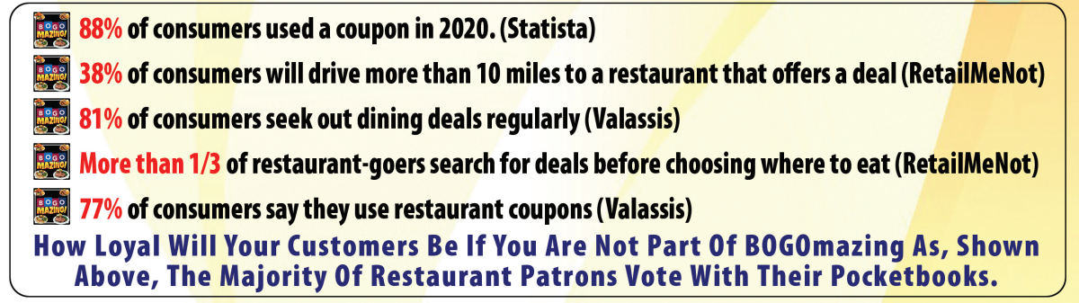
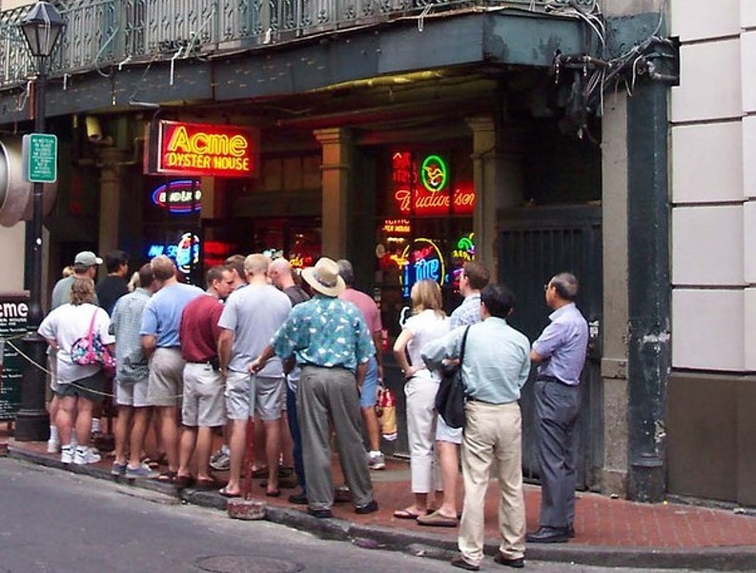
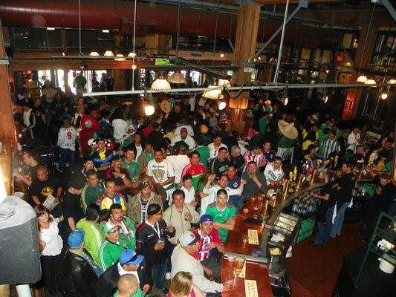
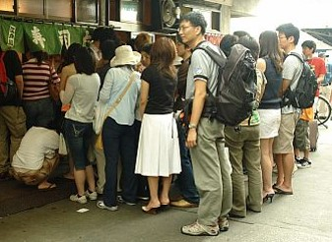
How Loyal Will Your Customers Be If You Are Not Part Of Your Dining Club?
These Statistics Show Value Propositions Drive Consumer Decisions On Where They Dine. All Economic Indicators Show These Numbers Will Only Continue To Rise.
Notes:
What most all restaurant consultants will tell any restaurant owner is that value propositions are the primary driver of how consumers make their decisions on how to spend their dining dollars. Few restaurants in the country are in the envious position to be at capacity through a given day and command full menu prices open to close. GRPs Restaurant Rescue was created for the majority of restaurants that are inflicted with the daily challenges of filling their perishable restaurant seats in the most competitive market on Earth.

Slide 20

BUY 4, GET 1 FREE – LOWEST REDEMPTION COST IN AMERICA
Your Dining Club Requires A Member With A Party Of 2 To Purchase 2 Drinks, 1 Select Appetizer (You Choose The Selections), 1 Select Entree (You Choose The Selections) To Then Receive A 5th Item For Free.
Notes:
Before we go any further, let me be clear that BOGOmazing is NOT actually a BOGO App or even close to it as you actually have to buy 4 items to then get the 5th item for free. BOGOmazing was chosen as it is the most used word in the food and restaurant business to attract the highest percentage of motivated consumers and diners. BOGOmazing requires the member to purchase 2 drinks, 1 more expensive appetizer and one more expensive entrée to then get a 5th menu item of equal or lesser value to exclude drinks, appetizers and desserts.

Slide 21

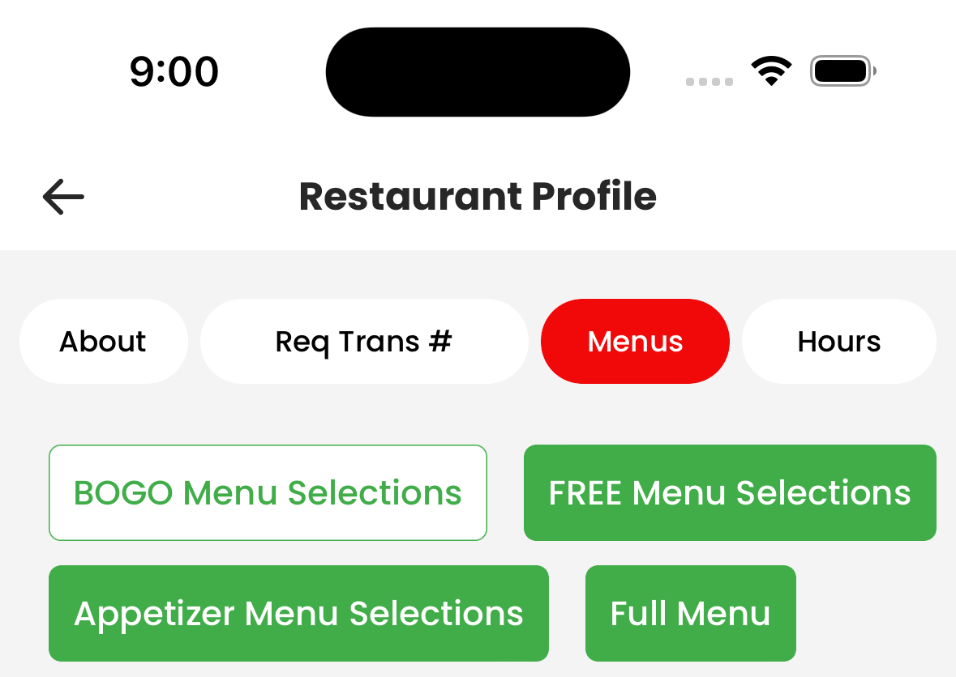
You Control All 3 Your Dining Club Menus
1
2
4
3
5
1
3
2
LOWEST REDEMPTION COST COMPARED TO ALL OTHER MARKETING PROGRAMS AND OPTIONS IN AMERICA
Redemption Cost Ranges From ONLY 9%-15% Depending On How Well Your Staff Does With Upselling Drinks, Appetizers & Desserts.
Notes:
Since BOGOmazing is buy 4 items and get the 5th item for free, Redemption cost is the lowest out of all marketing options available to any restaurant today with redemption cost ranging from 9 to 15 percent depending on how well your staff does with upselling drinks, appetizers and desserts. Obviously when you compare that to 30% to 50% delivery and restaurant discount apps take off the top, BOGOmazing is a no brainer for any bottom line driven restaurant owner based on that single point alone.

Slide 22
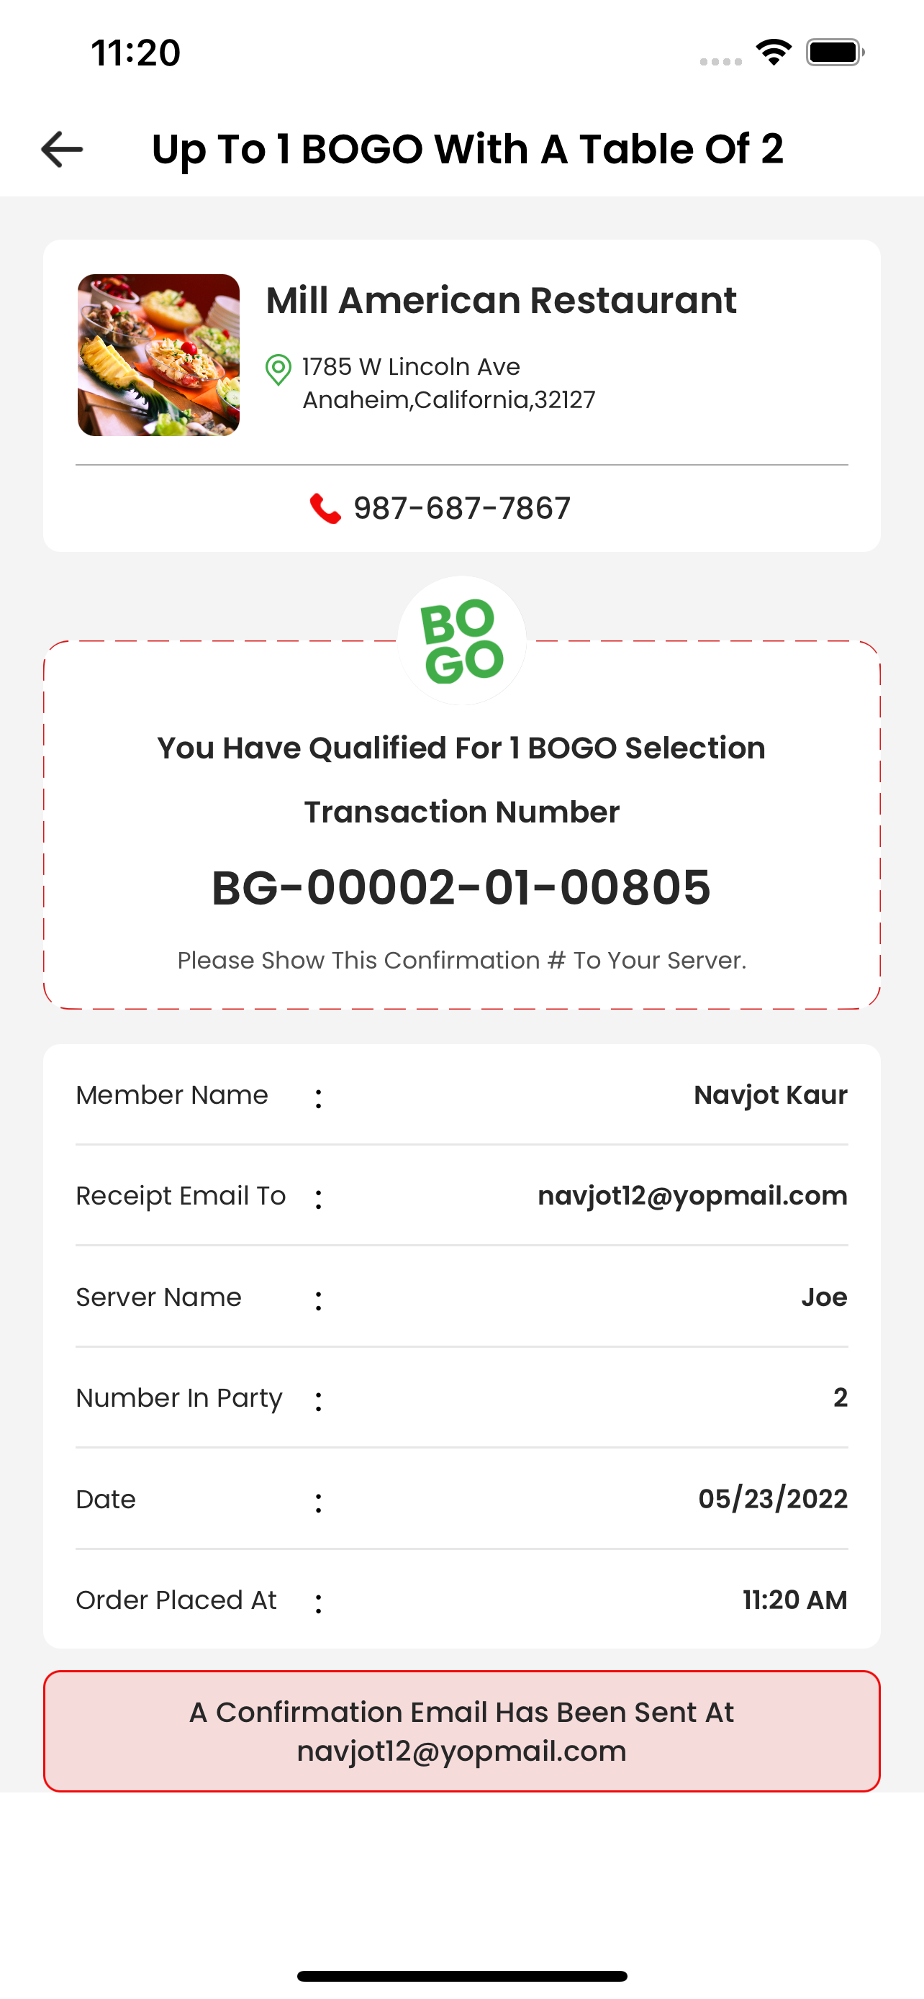



Fraud Proof
Your Dining Club Is Fraud Proof With Your Staff As A Unique Transaction Number, Member Name, Member Email, Server Name, # In Party, Date & Time Are Saved
.
Notes:
BOGOmazing is fraud proof with your staff as a unique transaction number is created as well as also displaying and saving the BOGOmazing members name & email, the server name, # in the party and the date & time or the redemption.

Slide 23
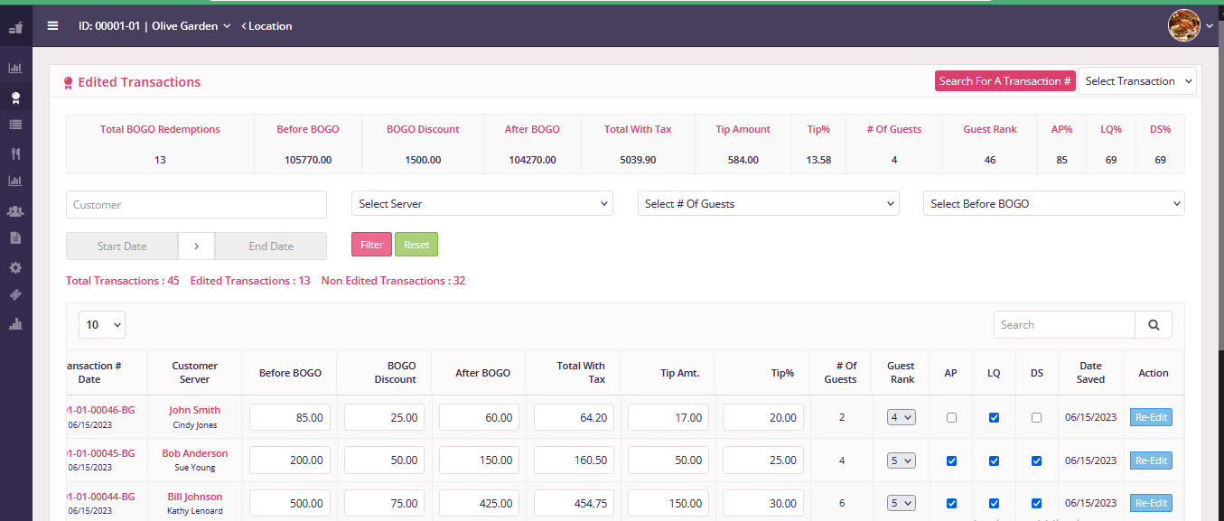

YOUR DINING CLUB TRANSACTION TRACKING SOFTWARE PROVIDED FOR FREE
Fields Populated From The App
Fields You Can Populate
Fields Automatically Calculated
FREE Your Dining Club Transaction Tracking Software
Tracks All Transactions & Allows For Additional Data To Be Entered If You Are A Total Type A Personality.
.
Notes:
For any type A type personality of restaurant owners, you will be very impressed with the FREE BOGOmazing Transaction Tracking Software portal you are provided for which automatically records the fields as previously just stated and also gives you the opportunity to enter in the amount of ticket before and after the bogomazing redemption, the tip amount as well as if the party has any additional appetizers, liquor drinks or desserts.

Slide 24
1
2
4
Your Dining Club – Americas’ First Customer Funded Marketing Platform In Where The Customer Picks Up 100% Of The Tab
3
5
NEVER PAY A COMMISSION
INSTEAD, GET PAID HUGE MONTHLY COMMISSIONS
Your Dining Club Is A Membership Driven Platform That Costs A Member ONLY $29.95 Per Month and
Can Easily Save A Member $500-$1,000 Per Month
Notes:
GRP created what I call Customer Funded Marketing in where the customer/member picks up 100% of the marketing expenses tab versus having to charge and take commissions from restaurants. BOGOmazing is a membership driven app that costs a member only $29.95 per month and can easily save a member $500 to $1000 per month if used just once per day or much more if used multiple times per day.

Slide 25
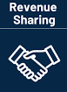
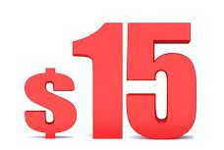






Per
Month
UP TO
Per Active Your Dining Club Member Referral
No Limits Or Caps
Up To 50% Of ALL Your Dining Club Revenue Collected Is Returned To Our Your Dining Club Restaurant Members In The Form Of Monthly Revenue Sharing Cash Commissions.
Notes:
Out of the $29.95 per month GRP Collects, 50% of all BOGOmazing Restaurant Revenue collected is returned to our GRP Restaurant Rescue Sponsors in the form of Monthly Cash Commissions. There are no limits or caps in how much GRP monthly commissions you can earn.

Slide 26
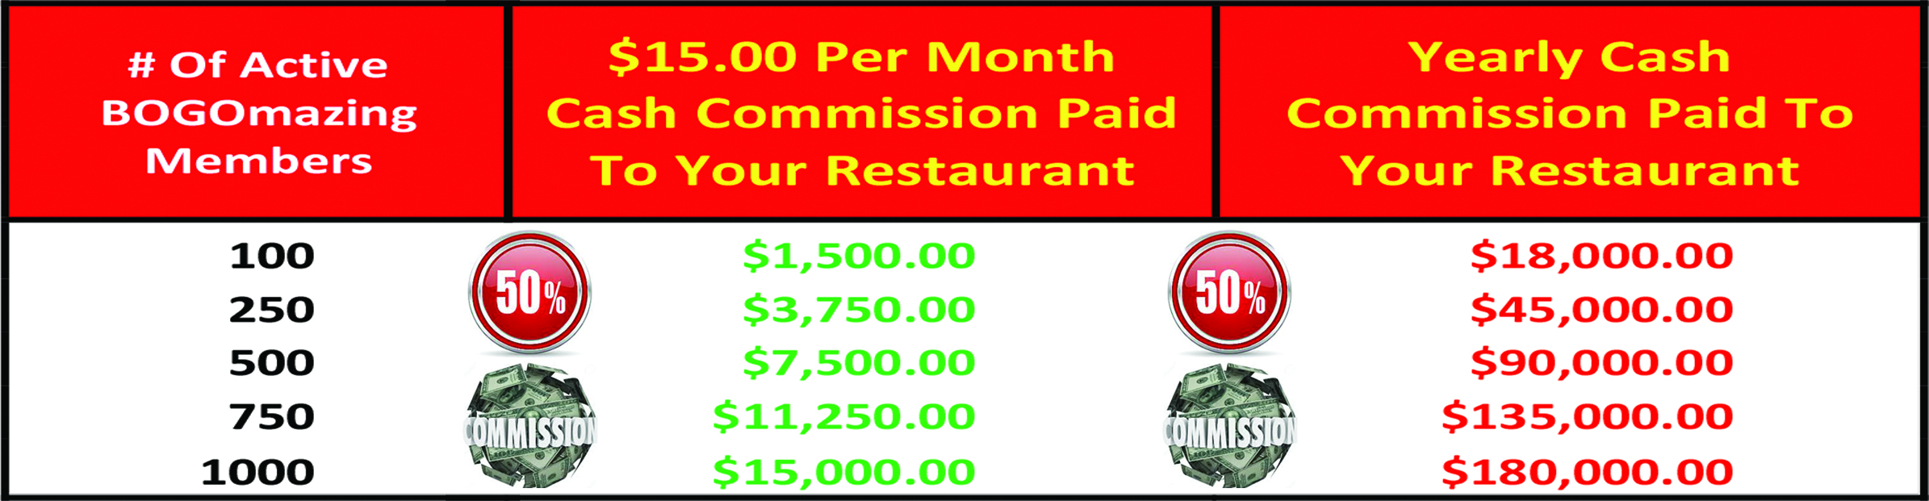
UP TO
Per
Month
# Of Active Your Dining Club Members
With Just 500 Referrals You Earn $7,500/Month & 1,000 Referrals A Restaurant Life Saving $15,000/Month. Many Restaurants Will Easily Double Their Bottom-Line Profits
Notes:
With just 500 BOGOmazing Referrals you earn a very respectable $7,500 per month. 1000 BOGOmazing Referrals earns you and your restaurant a very restaurant life saving $15,000 per month of 100% bottom line profits. For some restaurants, bringing an extra $100,000 to $150,000+ of risk free profits directly to the bottom line may be more than they are currently bringing to the bottom-line serving food and drink in this very competitive and challenging economy.

Slide 27
# Of Active Your Dining Club Members
What Would You Do With All This Effortless, Risk FREE, Restaurant Life Saving Bottom-Line Profits? Would This Be A Difference Maker For Your Restaurant?
Notes:
What would you do with all of this effortless, risk free, restaurant life saving bottom-line profits and would this be a difference maker for your restaurant? I think all listening would say absolutely it would.

Slide 28


So Lets Talk About How You Can Take A Big Step Forward Solving Staffing Challenges While Enabling Your Staff To Increase Your Bottom-Line Profits In Their Off Hours.
Notes:
So lets talk about how you can take a big step forward solving staffing challenges while enabling your staff to increase your bottom line profits in their off hours.

Slide 29





How An Employee Monthly Bonus Program Will Significantly Increase Staff Hiring, Motivation & Retention
While Further Exploding Your Bottom-Line Profits.
Notes:
In the end, every person works for your restaurant to earn as much money as they can and the more you can offer and the more they take home makes it much easier to hire, motivate and retain high quality staff which is the foundation to really exploding your bottom-line profits as a restaurants success will start and stop with the quality of their staff

Slide 30

UP TO
Per
Month
# Of Active Your Dining Club Members |  | $15.00 Per Month Cash Commission Paid To Your Restaurant | Yearly Cash Commissions Paid To Your Restaurant | $5.00 Per Month Cash Commission You Pay Your Staff | Yearly Cash Commissions You Pay Your Staff
10 |  | $150.00 | $1,800.00 | $50.00 | $600.00
25 |  | $375.00 | $4,500.00 | $125.00 | $1,500.00
50 |  | $750.00 | $9,000.00 | $250.00 | $3,000.00
75 |  | $1,125.00 | $13,500.00 | $375.00 | $4,500.00
100 |  | $1,500.00 | $18,000.00 | $500.00 | $6,000.00
125 |  | $1,875.00 | $22,500.00 | $625.00 | $7,500.00
150 |  | $2,250.00 | $27,000.00 | $750.00 | $9,000.00
How Motivated & Loyal Would Your Staff Be If They Could Earn A $250+ Monthly Commissions By Promoting Your Dining Club. I Would Say Extremely Loyal & Motivated
Notes:
How motivated and loyal would your staff be if they could earn an additional $250 or more in commissions by simply promoting BOGOmazing. For both the front and back of the house, a $250 monthly bonus being tied to them doing a great job while at work surely would go a long way to reducing turnover and increasing loyalty and motivation of your staff.

Slide 31

UP TO
Per
Month
# Of Active Your Dining Club Members |  | $15.00 Per Month Cash Commission Paid To Your Restaurant | Yearly Cash Commissions Paid To Your Restaurant | $5.00 Per Month Cash Commission You Pay Your Staff | Yearly Cash Commissions You Pay Your Staff
25 |  | $375.00 | $4,500.00 | $125.00 | $1,500.00
50 |  | $750.00 | $9,000.00 | $250.00 | $3,000.00
100 |  | $1,500.00 | $18,000.00 | $500.00 | $6,000.00
250 |  | $3,750.00 | $45,000.00 | $1,250.00 | $15,000.00
500 |  | $7,500.00 | $90,000.00 | $2,500.00 | $30,000.00
750 |  | $11,250.00 | $135,000.00 | $3,750.00 | $45,000.00
1000 |  | $15,000.00 | $180,000.00 | $5,000.00 | $60,000.00
The Referrals The FOH & BOH Staff Get Outside Of Work Is 100% Gravy Bottom-Line Profit That More Then Funds The Monthly Bonuses That Create A Much Happier Staff.
Notes:
The referrals the front and back of the house get outside of work is 100% gravy bottom line profit that more then funds the monthly bonuses that will truly create a much happier staff. Just 500 bogomazing referrals from your entire staff would put an additional $90,000 in your pocket per year while funding $30,000 in staff bonuses as well.

Slide 32
UP TO
Per
Month
# Of Active Your Dining Club Members |  | $15.00 Per Month Cash Commission Paid To Your Restaurant | Yearly Cash Commissions Paid To Your Restaurant | $5.00 Per Month Cash Commission You Pay Your Staff | Yearly Cash Commissions You Pay Your Staff
25 |  | $375.00 | $4,500.00 | $125.00 | $1,500.00
50 |  | $750.00 | $9,000.00 | $250.00 | $3,000.00
100 |  | $1,500.00 | $18,000.00 | $500.00 | $6,000.00
250 |  | $3,750.00 | $45,000.00 | $1,250.00 | $15,000.00
500 |  | $7,500.00 | $90,000.00 | $2,500.00 | $30,000.00
750 |  | $11,250.00 | $135,000.00 | $3,750.00 | $45,000.00
1000 |  | $15,000.00 | $180,000.00 | $5,000.00 | $60,000.00
With Just 25 Employees Finding Just 10 Your Dining Club Member Referrals Would Put An Additional $45,000 Per Year Of Bottom-Line Profit In Your Pocket.
Notes:
The referrals the front and back of the house get outside of work is 100% gravy bottom line profit that more then funds the monthly bonuses that will truly create a much happier staff. Just 500 bogomazing referrals from your entire staff would put an additional $90,000 in your pocket per year while funding $30,000 in staff bonuses as well.

Slide 33
Cash Flow Issues SOLVED
Empty Perishable Dining Seats SOLVED
No Commission Restaurant App SOLVED
High Food Cost Killing Profits SOLVED
Incredible Staffing Challenges SOLVED
Pay Up Front Marketing Risky & Costly SOLVED
Huge Competitive Advantage Finally SOLVED
As You Have Discovered, All 7 Problems Listed Above Have Been Addressed With Your Restaurant Profit Group & Your Dining Club All But Solving Each Challenge.
Notes:
As illustrated so far in this presentation is all 7 problems get address with cash flow issues being solved in a way no restaurant owner could have ever imagined, the number of empty perishable restaurant seats greatly reduced, eliminating having to part with huge commissions, extra bottom line cash coming in monthly to combat the negative effects of ever increasing food costs, an effective way to not only solve staffing challenges but to use staff in their off hours to increase your bottom line profits, not having to risk a single penny up front….or ever….on uncertain or unmeasureable marketing results and finally….a huge competitive advantage no restaurant has ever enjoyed with any other marketing option that has ever been available.

Slide 34



If All Your Restaurant Profit Group Offered Was What Was Just Outlined Without Risk Or Cost, It Is A No Brainer For Any Restaurant Owner Watching...But It Gets Even Better
Notes:
As illustrated so far in this presentation is all 7 problems get address with cash flow issues being solved in a way no restaurant owner could have ever imagined, the number of empty perishable restaurant seats greatly reduced, eliminating having to part with huge commissions, extra bottom line cash coming in monthly to combat the negative effects of ever increasing food costs, an effective way to not only solve staffing challenges but to use staff in their off hours to increase your bottom line profits, not having to risk a single penny up front….or ever….on uncertain or unmeasureable marketing results and finally….a huge competitive advantage no restaurant has ever enjoyed with any other marketing option that has ever been available.

Slide 35


The Remaining Slides Will Show You The Real Money & How It Is Impossible To NOT See Huge Increases In Bottom-Line Profits With Your Restaurant Profit Group & Your Dining Club
Notes:
The remaining slides will show you the money and how it is impossible to not see huge increases in bottom-line profits with bogomazing and the grp restaurant rescue.

Slide 36
YOUR DINING CLUB | Your Restaurant Current Situation | Your Restaurant Without Your Dining Club | Your Restaurant With Your Dining Club | % Increase With V. Without Your Dining Club
YOUR RESTAURANT BOTTOM-LINE PROFITS
Total Sales | $100,000.00 | $80,000.00 | $100,000.00
Your Dining Club Additional Sales (20% Estimated) |  |  | $20,000.00
Total Sales With Your Dining Club | $100,000.00 | $80,000.00 | $120,000.00 | 50%
Your Dining Club Redemption (Food) Cost (15% Maximum) |  |  | $3,000.00
Your Dining Club Net Sales After Redemption Cost |  |  | $17,000.00 | 17%
Gross Total Sales Including Your Dining Club |  |  | $117,000.00 | 17%
5% Profit Margin | $5,000.00 | $4,000.00 | $5,850.00 | 46.25%
7.5% Profit Margin | $7,500.00 | $6,000.00 | $8,775.00 | 46.25%
10% Profit Margin | $10,000.00 | $8,000.00 | $11,700.00 | 46.25%
Your Dining Club Monthly Commission 500 Members |  |  | $7,500.00
Total Net Profit 5% Profit Margin |  |  | $13,350.00 | 233.75%
Total Net Profit 7.5% Profit Margin |  |  | $16,225.00 | 170.41%
Total Net Profit 10% Profit Margin |  |  | $19,200.00 | 140.00%
Let Me Cover The Huge Positive Impact On Monthly Restaurant Sales & Bottom-Line Profits For Your Restaurant
Notes:
Let me first cover the huge positive impact on monthly restaurant sales and bottom line profits for a typical restaurant doing $100,000 per month in gross sales.

Slide 37
YOUR DINING CLUB | Your Restaurant Current Situation | Your Restaurant Without Your Dining Club | Your Restaurant With Your Dining Club | % Increase With V. Without Your Dining Club
YOUR RESTAURANT BOTTOM-LINE PROFITS
Total Sales | $100,000.00 | $80,000.00 | $100,000.00
Your Dining Club Additional Sales (20% Estimated) |  |  | $20,000.00
Total Sales With Your Dining Club | $100,000.00 | $80,000.00 | $120,000.00 | 50%
Your Dining Club Redemption (Food) Cost (15% Maximum) |  |  | $3,000.00
Your Dining Club Net Sales After Redemption Cost |  |  | $17,000.00 | 17%
Gross Total Sales Including Your Dining Club |  |  | $117,000.00 | 17%
5% Profit Margin | $5,000.00 | $4,000.00 | $5,850.00 | 46.25%
7.5% Profit Margin | $7,500.00 | $6,000.00 | $8,775.00 | 46.25%
10% Profit Margin | $10,000.00 | $8,000.00 | $11,700.00 | 46.25%
Your Dining Club Monthly Commission 500 Members |  |  | $7,500.00
Total Net Profit 5% Profit Margin |  |  | $13,350.00 | 233.75%
Total Net Profit 7.5% Profit Margin |  |  | $16,225.00 | 170.41%
Total Net Profit 10% Profit Margin |  |  | $19,200.00 | 140.00%
Restaurant Profits From 5% to 10% With The Average Restaurants Doing $100,000 Per Month
Notes:
Let me first cover the huge positive impact on monthly restaurant sales and bottom line profits for a typical restaurant doing $100,000 per month in gross sales.

Slide 38
YOUR DINING CLUB | Your Restaurant Current Situation | Your Restaurant Without Your Dining Club | Your Restaurant With Your Dining Club | % Increase With V. Without Your Dining Club
YOUR RESTAURANT BOTTOM-LINE PROFITS
Total Sales | $100,000.00 | $80,000.00 | $100,000.00
Your Dining Club Additional Sales (20% Estimated) |  |  | $20,000.00
Total Sales With Your Dining Club | $100,000.00 | $80,000.00 | $120,000.00 | 50%
Your Dining Club Redemption (Food) Cost (15% Maximum) |  |  | $3,000.00
Your Dining Club Net Sales After Redemption Cost |  |  | $17,000.00 | 17%
Gross Total Sales Including Your Dining Club |  |  | $117,000.00 | 17%
5% Profit Margin | $5,000.00 | $4,000.00 | $5,850.00 | 46.25%
7.5% Profit Margin | $7,500.00 | $6,000.00 | $8,775.00 | 46.25%
10% Profit Margin | $10,000.00 | $8,000.00 | $11,700.00 | 46.25%
Your Dining Club Monthly Commission 500 Members |  |  | $7,500.00
Total Net Profit 5% Profit Margin |  |  | $13,350.00 | 233.75%
Total Net Profit 7.5% Profit Margin |  |  | $16,225.00 | 170.41%
Total Net Profit 10% Profit Margin |  |  | $19,200.00 | 140.00%
Could Sales & Profits Decrease If You Are Not A Your Dining Club Restaurant Member As Most Diners Vote With Their Pocket Book.
Notes:
Let me first cover the huge positive impact on monthly restaurant sales and bottom line profits for a typical restaurant doing $100,000 per month in gross sales.

Slide 39
YOUR DINING CLUB | Your Restaurant Current Situation | Your Restaurant Without Your Dining Club | Your Restaurant With Your Dining Club | % Increase With V. Without Your Dining Club
YOUR RESTAURANT BOTTOM-LINE PROFITS
Total Sales | $100,000.00 | $80,000.00 | $100,000.00
Your Dining Club Additional Sales (20% Estimated) |  |  | $20,000.00
Total Sales With Your Dining Club | $100,000.00 | $80,000.00 | $120,000.00 | 50%
Your Dining Club Redemption (Food) Cost (15% Maximum) |  |  | $3,000.00
Your Dining Club Net Sales After Redemption Cost |  |  | $17,000.00 | 17%
Gross Total Sales Including Your Dining Club |  |  | $117,000.00 | 17%
5% Profit Margin | $5,000.00 | $4,000.00 | $5,850.00 | 46.25%
7.5% Profit Margin | $7,500.00 | $6,000.00 | $8,775.00 | 46.25%
10% Profit Margin | $10,000.00 | $8,000.00 | $11,700.00 | 46.25%
Your Dining Club Monthly Commission 500 Members |  |  | $7,500.00
Total Net Profit 5% Profit Margin |  |  | $13,350.00 | 233.75%
Total Net Profit 7.5% Profit Margin |  |  | $16,225.00 | 170.41%
Total Net Profit 10% Profit Margin |  |  | $19,200.00 | 140.00%
With Your Dining Club Our Member Restaurants Could See Sales Increases At 20% Or More As Your Dining Club Members Increase.
Notes:
Let me first cover the huge positive impact on monthly restaurant sales and bottom line profits for a typical restaurant doing $100,000 per month in gross sales.

Slide 40
YOUR DINING CLUB | Your Restaurant Current Situation | Your Restaurant Without Your Dining Club | Your Restaurant With Your Dining Club | % Increase With V. Without Your Dining Club
YOUR RESTAURANT BOTTOM-LINE PROFITS
Total Sales | $100,000.00 | $80,000.00 | $100,000.00
Your Dining Club Additional Sales (20% Estimated) |  |  | $20,000.00
Total Sales With Your Dining Club | $100,000.00 | $80,000.00 | $120,000.00 | 50%
Your Dining Club Redemption (Food) Cost (15% Maximum) |  |  | $3,000.00
Your Dining Club Net Sales After Redemption Cost |  |  | $17,000.00 | 17%
Gross Total Sales Including Your Dining Club |  |  | $117,000.00 | 17%
5% Profit Margin | $5,000.00 | $4,000.00 | $5,850.00 | 46.25%
7.5% Profit Margin | $7,500.00 | $6,000.00 | $8,775.00 | 46.25%
10% Profit Margin | $10,000.00 | $8,000.00 | $11,700.00 | 46.25%
Your Dining Club Monthly Commission 500 Members |  |  | $7,500.00
Total Net Profit 5% Profit Margin |  |  | $13,350.00 | 233.75%
Total Net Profit 7.5% Profit Margin |  |  | $16,225.00 | 170.41%
Total Net Profit 10% Profit Margin |  |  | $19,200.00 | 140.00%
With Your Dining Club Having The Lowest Redemption Cost In America Of ONLY 9% to 15%, Your Profits Will Absolutely Explode.
Notes:
Let me first cover the huge positive impact on monthly restaurant sales and bottom line profits for a typical restaurant doing $100,000 per month in gross sales.

Slide 41
YOUR DINING CLUB | Your Restaurant Current Situation | Your Restaurant Without Your Dining Club | Your Restaurant With Your Dining Club | % Increase With V. Without Your Dining Club
YOUR RESTAURANT BOTTOM-LINE PROFITS
Total Sales | $100,000.00 | $80,000.00 | $100,000.00
Your Dining Club Additional Sales (20% Estimated) |  |  | $20,000.00
Total Sales With Your Dining Club | $100,000.00 | $80,000.00 | $120,000.00 | 50%
Your Dining Club Redemption (Food) Cost (15%) |  |  | $3,000.00
Your Dining Club Net Sales After Redemption Cost |  |  | $17,000.00 | 17%
Gross Total Sales Including Your Dining Club |  |  | $117,000.00 | 17%
5% Profit Margin | $5,000.00 | $4,000.00 | $5,850.00 | 46.25%
7.5% Profit Margin | $7,500.00 | $6,000.00 | $8,775.00 | 46.25%
10% Profit Margin | $10,000.00 | $8,000.00 | $11,700.00 | 46.25%
Your Dining Club Monthly Commission 500 Members |  |  | $7,500.00
Total Net Profit 5% Profit Margin |  |  | $13,350.00 | 233.75%
Total Net Profit 7.5% Profit Margin |  |  | $16,225.00 | 170.41%
Total Net Profit 10% Profit Margin |  |  | $19,200.00 | 140.00%
Regardless Of Your Profit Margin, Your Net Bottom-Line Profits Has Increased Making Your Dining Club Risk Free & A No Brainer!!!
Notes:
Let me first cover the huge positive impact on monthly restaurant sales and bottom line profits for a typical restaurant doing $100,000 per month in gross sales.

Slide 42
YOUR DINING CLUB | Your Restaurant Current Situation | Your Restaurant Without Your Dining Club | Your Restaurant With Your Dining Club | % Increase With V. Without Your Dining Club
YOUR RESTAURANT BOTTOM-LINE PROFITS
Total Sales | $100,000.00 | $80,000.00 | $100,000.00
Your Dining Club Additional Sales (20% Estimated) |  |  | $20,000.00
Total Sales With Your Dining Club | $100,000.00 | $80,000.00 | $120,000.00 | 50%
Your Dining Club Redemption (Food) Cost (15%) |  |  | $3,000.00
Your Dining Club Net Sales After Redemption Cost |  |  | $17,000.00 | 17%
Gross Total Sales Including Your Dining Club |  |  | $117,000.00 | 17%
5% Profit Margin | $5,000.00 | $4,000.00 | $5,850.00 | 46.25%
7.5% Profit Margin | $7,500.00 | $6,000.00 | $8,775.00 | 46.25%
10% Profit Margin | $10,000.00 | $8,000.00 | $11,700.00 | 46.25%
Your Dining Club Monthly Commission 500 Members |  |  | $7,500.00
Total Net Profit 5% Profit Margin |  |  | $13,350.00 | 233.75%
Total Net Profit 7.5% Profit Margin |  |  | $16,225.00 | 170.41%
Total Net Profit 10% Profit Margin |  |  | $19,200.00 | 140.00%
Now Lets See The Impact Of Your Dining Club Monthly Cash Commissions Being Added To Your Already Increasing Bottom-Line.
Notes:
Let me first cover the huge positive impact on monthly restaurant sales and bottom line profits for a typical restaurant doing $100,000 per month in gross sales.

Slide 43
YOUR DINING CLUB | Your Restaurant Current Situation | Your Restaurant Without Your Dining Club | Your Restaurant With Your Dining Club | % Increase With V. Without Your Dining Club
YOUR RESTAURANT BOTTOM-LINE PROFITS
Total Sales | $100,000.00 | $80,000.00 | $100,000.00
Your Dining Club Additional Sales (20% Estimated) |  |  | $20,000.00
Total Sales With Your Dining Club | $100,000.00 | $80,000.00 | $120,000.00 | 50%
Your Dining Club Redemption (Food) Cost (15%) |  |  | $3,000.00
Your Dining Club Net Sales After Redemption Cost |  |  | $17,000.00 | 17%
Gross Total Sales Including Your Dining Club |  |  | $117,000.00 | 17%
5% Profit Margin | $5,000.00 | $4,000.00 | $5,850.00 | 46.25%
7.5% Profit Margin | $7,500.00 | $6,000.00 | $8,775.00 | 46.25%
10% Profit Margin | $10,000.00 | $8,000.00 | $11,700.00 | 46.25%
Your Dining Club Monthly Commission 500 Members |  |  | $7,500.00
Total Net Profit 5% Profit Margin |  |  | $13,350.00 | 233.75%
Total Net Profit 7.5% Profit Margin |  |  | $16,225.00 | 170.41%
Total Net Profit 10% Profit Margin |  |  | $19,200.00 | 140.00%
As You Can See, Your Bottom-Line Profit Dollars Have More Then Doubled In Every Case With 10% Being Not Quite Double.
Notes:
Let me first cover the huge positive impact on monthly restaurant sales and bottom line profits for a typical restaurant doing $100,000 per month in gross sales.

Slide 44
YOUR DINING CLUB | Your Restaurant Current Situation | Your Restaurant Without Your Dining Club | Your Restaurant With Your Dining Club | % Increase With V. Without Your Dining Club
YOUR RESTAURANT BOTTOM-LINE PROFITS
Total Sales | $100,000.00 | $80,000.00 | $100,000.00
Your Dining Club Additional Sales (20% Estimated) |  |  | $20,000.00
Total Sales With Your Dining Club | $100,000.00 | $80,000.00 | $120,000.00 | 50%
Your Dining Club Redemption (Food) Cost (15%) |  |  | $3,000.00
Your Dining Club Net Sales After Redemption Cost |  |  | $17,000.00 | 17%
Gross Total Sales Including Your Dining Club |  |  | $117,000.00 | 17%
5% Profit Margin | $5,000.00 | $4,000.00 | $5,850.00 | 46.25%
7.5% Profit Margin | $7,500.00 | $6,000.00 | $8,775.00 | 46.25%
10% Profit Margin | $10,000.00 | $8,000.00 | $11,700.00 | 46.25%
Your Dining Club Monthly Commission 500 Members |  |  | $7,500.00
Total Net Profit 5% Profit Margin |  |  | $13,350.00 | 233.75%
Total Net Profit 7.5% Profit Margin |  |  | $16,225.00 | 170.41%
Total Net Profit 10% Profit Margin |  |  | $19,200.00 | 140.00%
Regardless Of What We Are Looking At, Your Restaurant Profit Group & Your Dining Club Increases All Metrics For Your Restaurant.
Notes:
Let me first cover the huge positive impact on monthly restaurant sales and bottom line profits for a typical restaurant doing $100,000 per month in gross sales.

Slide 45
Your Dining Club Great Regular Profits | Great Regulars & Where You Are At Today | Great Regulars You Sign Up With Your Dining Club With Same Check Size | Great Regulars You Sign Up With Your Dining Club With Staff Upselling | Infrequent Diner You Sign Up With Your Dining Club With Same Check Size | Your Great Regulars Going To A Restaurant With Your Dining Club That You Do Not Have
Bottom Line Profits Per Party Of 2
# Of Restaurant Visits Per Month | 8 | 8 | 8 | 1 | 0
Average Ticket (2 People) | $75.00 | $75.00 | $85.00 | $75.00 | $0.00
Gross Ticket Total | $600.00 | $600.00 | $680.00 | $75.00 | $0.00
$25.00 Entrée X 8 Visits Discount |  | $200.00 | $200.00 | $25.00 | $0.00
Net Sales After Your Dining Club Discount |  | $400.00 | $480.00 | $50.00 | $0.00
Total Profit With A 5% Profit Margin | $30.00 | $20.00 | $24.00 | $2.50 | $0.00
Your Dining Club Monthly Commission | $0.00 | $15.00 | $15.00 | $15.00 | $0.00
Total Net Profit After Your Dining Club Commission | $30.00 | $35.00 | $39.00 | $17.50 | $0.00
Profit Per Visit With 5% Profit Margin | $3.75 | $4.38 | $4.88 | $17.50 | $0.00
Total Profit With A 7.5% Profit Margin | $45.00 | $30.00 | $36.00 | $3.75 | $0.00
Your Dining Club Monthly Commission | $0.00 | $15.00 | $15.00 | $15.00 | $0.00
Total Net Profit After Your Dining Club Commission | $45.00 | $45.00 | $51.00 | $18.75 | $0.00
Profit Per Visit With 7.5% Profit Margin | $5.63 | $5.63 | $6.38 | $18.75 | $0.00
How To Turn Your Best Regular Diners Into More Bottom-Line Profits Versus Potentially Losing Them
Notes:
I wanted to show one more chart before I wrap up this presentation to address one possible last confusion some restaurant owners may have regarding bottom-line profitability and how BOGOmazing applies to your best customers. I will show you how actually your best regulars will be the foundation to further increasing your bottom line profits versus a very high probably of losing your best regular customers to other restaurants in BOGOmazing if your restaurant is not chosen to be part of the GRP Restaurant Rescue

Slide 46
Your Dining Club Great Regular Profits | Great Regulars & Where You Are At Today | Great Regulars You Sign Up With Your Dining Club With Same Check Size | Great Regulars You Sign Up With Your Dining Club With Staff Upselling | Infrequent Diner You Sign Up With Your Dining Club With Same Check Size | Your Great Regulars Going To A Restaurant With Your Dining Club That You Do Not Have
Bottom Line Profits Per Party Of 2
# Of Restaurant Visits Per Month | 8 | 8 | 8 | 1 | 0
Average Ticket (2 People) | $75.00 | $75.00 | $85.00 | $75.00 | $0.00
Gross Ticket Total | $600.00 | $600.00 | $680.00 | $75.00 | $0.00
$25.00 Entrée X 8 Visits Discount |  | $200.00 | $200.00 | $25.00 | $0.00
Net Sales After Your Dining Club Discount |  | $400.00 | $480.00 | $50.00 | $0.00
Total Profit With A 5% Profit Margin | $30.00 | $20.00 | $24.00 | $2.50 | $0.00
Your Dining Club Monthly Commission | $0.00 | $15.00 | $15.00 | $15.00 | $0.00
Total Net Profit After Your Dining Club Commission | $30.00 | $35.00 | $39.00 | $17.50 | $0.00
Profit Per Visit With 5% Profit Margin | $3.75 | $4.38 | $4.88 | $17.50 | $0.00
Total Profit With A 7.5% Profit Margin | $45.00 | $30.00 | $36.00 | $3.75 | $0.00
Your Dining Club Monthly Commission | $0.00 | $15.00 | $15.00 | $15.00 | $0.00
Total Net Profit After Your Dining Club Commission | $45.00 | $45.00 | $51.00 | $18.75 | $0.00
Profit Per Visit With 7.5% Profit Margin | $5.63 | $5.63 | $6.38 | $18.75 | $0.00
Lets Look At A Fantastic Regular Couple Spending $600 Per Month On 8 Visits Per Month
Notes:
I wanted to show one more chart before I wrap up this presentation to address one possible last confusion some restaurant owners may have regarding bottom-line profitability and how BOGOmazing applies to your best customers. I will show you how actually your best regulars will be the foundation to further increasing your bottom line profits versus a very high probably of losing your best regular customers to other restaurants in BOGOmazing if your restaurant is not chosen to be part of the GRP Restaurant Rescue

Slide 47
Your Dining Club Great Regular Profits | Great Regulars & Where You Are At Today | Great Regulars You Sign Up With Your Dining Club With Same Check Size | Great Regulars You Sign Up With Your Dining Club With Staff Upselling | Infrequent Diner You Sign Up With Your Dining Club With Same Check Size | Your Great Regulars Going To A Restaurant With Your Dining Club That You Do Not Have
Bottom Line Profits Per Party Of 2
# Of Restaurant Visits Per Month | 8 | 8 | 8 | 1 | 0
Average Ticket (2 People) | $75.00 | $75.00 | $85.00 | $75.00 | $0.00
Gross Ticket Total | $600.00 | $600.00 | $680.00 | $75.00 | $0.00
$25.00 Entrée X 8 Visits Discount |  | $200.00 | $200.00 | $25.00 | $0.00
Net Sales After Your Dining Club Discount |  | $400.00 | $480.00 | $50.00 | $0.00
Total Profit With A 5% Profit Margin | $30.00 | $20.00 | $24.00 | $2.50 | $0.00
Your Dining Club Monthly Commission | $0.00 | $15.00 | $15.00 | $15.00 | $0.00
Total Net Profit After Your Dining Club Commission | $30.00 | $35.00 | $39.00 | $17.50 | $0.00
Profit Per Visit With 5% Profit Margin | $3.75 | $4.38 | $4.88 | $17.50 | $0.00
Total Profit With A 7.5% Profit Margin | $45.00 | $30.00 | $36.00 | $3.75 | $0.00
Your Dining Club Monthly Commission | $0.00 | $15.00 | $15.00 | $15.00 | $0.00
Total Net Profit After Your Dining Club Commission | $45.00 | $45.00 | $51.00 | $18.75 | $0.00
Profit Per Visit With 7.5% Profit Margin | $5.63 | $5.63 | $6.38 | $18.75 | $0.00
Here You Can See Profit Per Visit For Both A 5% & 7.5% Profit Margin
Notes:
I wanted to show one more chart before I wrap up this presentation to address one possible last confusion some restaurant owners may have regarding bottom-line profitability and how BOGOmazing applies to your best customers. I will show you how actually your best regulars will be the foundation to further increasing your bottom line profits versus a very high probably of losing your best regular customers to other restaurants in BOGOmazing if your restaurant is not chosen to be part of the GRP Restaurant Rescue

Slide 48
Your Dining Club Great Regular Profits | Great Regulars & Where You Are At Today | Great Regulars You Sign Up With Your Dining Club With Same Check Size | Great Regulars You Sign Up With Your Dining Club With Staff Upselling | Infrequent Diner You Sign Up With Your Dining Club With Same Check Size | Your Great Regulars Going To A Restaurant With Your Dining Club That You Do Not Have
Bottom Line Profits Per Party Of 2
# Of Restaurant Visits Per Month | 8 | 8 | 8 | 1 | 0
Average Ticket (2 People) | $75.00 | $75.00 | $85.00 | $75.00 | $0.00
Gross Ticket Total | $600.00 | $600.00 | $680.00 | $75.00 | $0.00
$25.00 Entrée X 8 Visits Discount |  | $200.00 | $200.00 | $25.00 | $0.00
Net Sales After Your Dining Club Discount |  | $400.00 | $480.00 | $50.00 | $0.00
Total Profit With A 5% Profit Margin | $30.00 | $20.00 | $24.00 | $2.50 | $0.00
Your Dining Club Monthly Commission | $0.00 | $15.00 | $15.00 | $15.00 | $0.00
Total Net Profit After Your Dining Club Commission | $30.00 | $35.00 | $39.00 | $17.50 | $0.00
Profit Per Visit With 5% Profit Margin | $3.75 | $4.38 | $4.88 | $17.50 | $0.00
Total Profit With A 7.5% Profit Margin | $45.00 | $30.00 | $36.00 | $3.75 | $0.00
Your Dining Club Monthly Commission | $0.00 | $15.00 | $15.00 | $15.00 | $0.00
Total Net Profit After Your Dining Club Commission | $45.00 | $45.00 | $51.00 | $18.75 | $0.00
Profit Per Visit With 7.5% Profit Margin | $5.63 | $5.63 | $6.38 | $18.75 | $0.00
Now Lets Review How Your Dining Club Revenue Sharing Commissions Effect Your Bottom-Line Profits
Notes:
I wanted to show one more chart before I wrap up this presentation to address one possible last confusion some restaurant owners may have regarding bottom-line profitability and how BOGOmazing applies to your best customers. I will show you how actually your best regulars will be the foundation to further increasing your bottom line profits versus a very high probably of losing your best regular customers to other restaurants in BOGOmazing if your restaurant is not chosen to be part of the GRP Restaurant Rescue

Slide 49
Your Dining Club Great Regular Profits | Great Regulars & Where You Are At Today | Great Regulars You Sign Up With Your Dining Club With Same Check Size | Great Regulars You Sign Up With Your Dining Club With Staff Upselling | Infrequent Diner You Sign Up With Your Dining Club With Same Check Size | Your Great Regulars Going To A Restaurant With Your Dining Club That You Do Not Have
Bottom Line Profits Per Party Of 2
# Of Restaurant Visits Per Month | 8 | 8 | 8 | 1 | 0
Average Ticket (2 People) | $75.00 | $75.00 | $85.00 | $75.00 | $0.00
Gross Ticket Total | $600.00 | $600.00 | $680.00 | $75.00 | $0.00
$25.00 Entrée X 8 Visits Discount |  | $200.00 | $200.00 | $25.00 | $0.00
Net Sales After Your Dining Club Discount |  | $400.00 | $480.00 | $50.00 | $0.00
Total Profit With A 5% Profit Margin | $30.00 | $20.00 | $24.00 | $2.50 | $0.00
Your Dining Club Monthly Commission | $0.00 | $15.00 | $15.00 | $15.00 | $0.00
Total Net Profit After Your Dining Club Commission | $30.00 | $35.00 | $39.00 | $17.50 | $0.00
Profit Per Visit With 5% Profit Margin | $3.75 | $4.38 | $4.88 | $17.50 | $0.00
Total Profit With A 7.5% Profit Margin | $45.00 | $30.00 | $36.00 | $3.75 | $0.00
Your Dining Club Monthly Commission | $0.00 | $15.00 | $15.00 | $15.00 | $0.00
Total Net Profit After Your Dining Club Commission | $45.00 | $45.00 | $51.00 | $18.75 | $0.00
Profit Per Visit With 7.5% Profit Margin | $5.63 | $5.63 | $6.38 | $18.75 | $0.00
Here Shows The $200.00 Your Dining Club Discount For The FREE Entree Subtracted From The Same Size Checks.
Notes:
I wanted to show one more chart before I wrap up this presentation to address one possible last confusion some restaurant owners may have regarding bottom-line profitability and how BOGOmazing applies to your best customers. I will show you how actually your best regulars will be the foundation to further increasing your bottom line profits versus a very high probably of losing your best regular customers to other restaurants in BOGOmazing if your restaurant is not chosen to be part of the GRP Restaurant Rescue

Slide 50
Your Dining Club Great Regular Profits | Great Regulars & Where You Are At Today | Great Regulars You Sign Up With Your Dining Club With Same Check Size | Great Regulars You Sign Up With Your Dining Club With Staff Upselling | Infrequent Diner You Sign Up With Your Dining Club With Same Check Size | Your Great Regulars Going To A Restaurant With Your Dining Club That You Do Not Have
Bottom Line Profits Per Party Of 2
# Of Restaurant Visits Per Month | 8 | 8 | 8 | 1 | 0
Average Ticket (2 People) | $75.00 | $75.00 | $85.00 | $75.00 | $0.00
Gross Ticket Total | $600.00 | $600.00 | $680.00 | $75.00 | $0.00
$25.00 Entrée X 8 Visits Discount |  | $200.00 | $200.00 | $25.00 | $0.00
Net Sales After Your Dining Club Discount |  | $400.00 | $480.00 | $50.00 | $0.00
Total Profit With A 5% Profit Margin | $30.00 | $20.00 | $24.00 | $2.50 | $0.00
Your Dining Club Monthly Commission | $0.00 | $15.00 | $15.00 | $15.00 | $0.00
Total Net Profit After Your Dining Club Commission | $30.00 | $35.00 | $39.00 | $17.50 | $0.00
Profit Per Visit With 5% Profit Margin | $3.75 | $4.38 | $4.88 | $17.50 | $0.00
Total Profit With A 7.5% Profit Margin | $45.00 | $30.00 | $36.00 | $3.75 | $0.00
Your Dining Club Monthly Commission | $0.00 | $15.00 | $15.00 | $15.00 | $0.00
Total Net Profit After Your Dining Club Commission | $45.00 | $45.00 | $51.00 | $18.75 | $0.00
Profit Per Visit With 7.5% Profit Margin | $5.63 | $5.63 | $6.38 | $18.75 | $0.00
Here Shows Profits Once You Add In The $15.00 Per Month Your Dining Club Revenue Sharing Commissions.
Notes:
I wanted to show one more chart before I wrap up this presentation to address one possible last confusion some restaurant owners may have regarding bottom-line profitability and how BOGOmazing applies to your best customers. I will show you how actually your best regulars will be the foundation to further increasing your bottom line profits versus a very high probably of losing your best regular customers to other restaurants in BOGOmazing if your restaurant is not chosen to be part of the GRP Restaurant Rescue

Slide 51
Your Dining Club Great Regular Profits | Great Regulars & Where You Are At Today | Great Regulars You Sign Up With Your Dining Club With Same Check Size | Great Regulars You Sign Up With Your Dining Club With Staff Upselling | Infrequent Diner You Sign Up With Your Dining Club With Same Check Size | Your Great Regulars Going To A Restaurant With Your Dining Club That You Do Not Have
Bottom Line Profits Per Party Of 2
# Of Restaurant Visits Per Month | 8 | 8 | 8 | 1 | 0
Average Ticket (2 People) | $75.00 | $75.00 | $85.00 | $75.00 | $0.00
Gross Ticket Total | $600.00 | $600.00 | $680.00 | $75.00 | $0.00
$25.00 Entrée X 8 Visits Discount |  | $200.00 | $200.00 | $25.00 | $0.00
Net Sales After Your Dining Club Discount |  | $400.00 | $480.00 | $50.00 | $0.00
Total Profit With A 5% Profit Margin | $30.00 | $20.00 | $24.00 | $2.50 | $0.00
Your Dining Club Monthly Commission | $0.00 | $15.00 | $15.00 | $15.00 | $0.00
Total Net Profit After Your Dining Club Commission | $30.00 | $35.00 | $39.00 | $17.50 | $0.00
Profit Per Visit With 5% Profit Margin | $3.75 | $4.38 | $4.88 | $17.50 | $0.00
Total Profit With A 7.5% Profit Margin | $45.00 | $30.00 | $36.00 | $3.75 | $0.00
Your Dining Club Monthly Commission | $0.00 | $15.00 | $15.00 | $15.00 | $0.00
Total Net Profit After Your Dining Club Commission | $45.00 | $45.00 | $51.00 | $18.75 | $0.00
Profit Per Visit With 7.5% Profit Margin | $5.63 | $5.63 | $6.38 | $18.75 | $0.00
A Great Regular Now Saving $25.00 Per Visit Will Easily Spend An Extra $10.00 Per Visit With New Found Money.
Notes:
I wanted to show one more chart before I wrap up this presentation to address one possible last confusion some restaurant owners may have regarding bottom-line profitability and how BOGOmazing applies to your best customers. I will show you how actually your best regulars will be the foundation to further increasing your bottom line profits versus a very high probably of losing your best regular customers to other restaurants in BOGOmazing if your restaurant is not chosen to be part of the GRP Restaurant Rescue

Slide 52
Your Dining Club Great Regular Profits | Great Regulars & Where You Are At Today | Great Regulars You Sign Up With Your Dining Club With Same Check Size | Great Regulars You Sign Up With Your Dining Club With Staff Upselling | Infrequent Diner You Sign Up With Your Dining Club With Same Check Size | Your Great Regulars Going To A Restaurant With Your Dining Club That You Do Not Have
Bottom Line Profits Per Party Of 2
# Of Restaurant Visits Per Month | 8 | 8 | 8 | 1 | 0
Average Ticket (2 People) | $75.00 | $75.00 | $85.00 | $75.00 | $0.00
Gross Ticket Total | $600.00 | $600.00 | $680.00 | $75.00 | $0.00
$25.00 Entrée X 8 Visits Discount |  | $200.00 | $200.00 | $25.00 | $0.00
Net Sales After Your Dining Club Discount |  | $400.00 | $480.00 | $50.00 | $0.00
Total Profit With A 5% Profit Margin | $30.00 | $20.00 | $24.00 | $2.50 | $0.00
Your Dining Club Monthly Commission | $0.00 | $15.00 | $15.00 | $15.00 | $0.00
Total Net Profit After Your Dining Club Commission | $30.00 | $35.00 | $39.00 | $17.50 | $0.00
Profit Per Visit With 5% Profit Margin | $3.75 | $4.38 | $4.88 | $17.50 | $0.00
Total Profit With A 7.5% Profit Margin | $45.00 | $30.00 | $36.00 | $3.75 | $0.00
Your Dining Club Monthly Commission | $0.00 | $15.00 | $15.00 | $15.00 | $0.00
Total Net Profit After Your Dining Club Commission | $45.00 | $45.00 | $51.00 | $18.75 | $0.00
Profit Per Visit With 7.5% Profit Margin | $5.63 | $5.63 | $6.38 | $18.75 | $0.00
Your Regulars Will Spend More Money Creating Higher Ticket Averages & Higher Bottom-Line Profits.
Notes:
I wanted to show one more chart before I wrap up this presentation to address one possible last confusion some restaurant owners may have regarding bottom-line profitability and how BOGOmazing applies to your best customers. I will show you how actually your best regulars will be the foundation to further increasing your bottom line profits versus a very high probably of losing your best regular customers to other restaurants in BOGOmazing if your restaurant is not chosen to be part of the GRP Restaurant Rescue

Slide 53
Your Dining Club Great Regular Profits | Great Regulars & Where You Are At Today | Great Regulars You Sign Up With Your Dining Club With Same Check Size | Great Regulars You Sign Up With Your Dining Club With Staff Upselling | Infrequent Diner You Sign Up With Your Dining Club With Same Check Size | Your Great Regulars Going To A Restaurant With Your Dining Club That You Do Not Have
Bottom Line Profits Per Party Of 2
# Of Restaurant Visits Per Month | 8 | 8 | 8 | 1 | 0
Average Ticket (2 People) | $75.00 | $75.00 | $85.00 | $75.00 | $0.00
Gross Ticket Total | $600.00 | $600.00 | $680.00 | $75.00 | $0.00
$25.00 Entrée X 8 Visits Discount |  | $200.00 | $200.00 | $25.00 | $0.00
Net Sales After Your Dining Club Discount |  | $400.00 | $480.00 | $50.00 | $0.00
Total Profit With A 5% Profit Margin | $30.00 | $20.00 | $24.00 | $2.50 | $0.00
Your Dining Club Monthly Commission | $0.00 | $15.00 | $15.00 | $15.00 | $0.00
Total Net Profit After Your Dining Club Commission | $30.00 | $35.00 | $39.00 | $17.50 | $0.00
Profit Per Visit With 5% Profit Margin | $3.75 | $4.38 | $4.88 | $17.50 | $0.00
Total Profit With A 7.5% Profit Margin | $45.00 | $30.00 | $36.00 | $3.75 | $0.00
Your Dining Club Monthly Commission | $0.00 | $15.00 | $15.00 | $15.00 | $0.00
Total Net Profit After Your Dining Club Commission | $45.00 | $45.00 | $51.00 | $18.75 | $0.00
Profit Per Visit With 7.5% Profit Margin | $5.63 | $5.63 | $6.38 | $18.75 | $0.00
Make Record Profits From Your Dining Club Members Who Sign Up At Your Restaurant But Dine At Restaurants Closer To Their Home.
Notes:
I wanted to show one more chart before I wrap up this presentation to address one possible last confusion some restaurant owners may have regarding bottom-line profitability and how BOGOmazing applies to your best customers. I will show you how actually your best regulars will be the foundation to further increasing your bottom line profits versus a very high probably of losing your best regular customers to other restaurants in BOGOmazing if your restaurant is not chosen to be part of the GRP Restaurant Rescue

Slide 54
Your Dining Club Great Regular Profits | Great Regulars & Where You Are At Today | Great Regulars You Sign Up With Your Dining Club With Same Check Size | Great Regulars You Sign Up With Your Dining Club With Staff Upselling | Infrequent Diner You Sign Up With Your Dining Club With Same Check Size | Your Great Regulars Going To A Restaurant With Your Dining Club That You Do Not Have
Bottom Line Profits Per Party Of 2
# Of Restaurant Visits Per Month | 8 | 8 | 8 | 1 | 0
Average Ticket (2 People) | $75.00 | $75.00 | $85.00 | $75.00 | $0.00
Gross Ticket Total | $600.00 | $600.00 | $680.00 | $75.00 | $0.00
$25.00 Entrée X 8 Visits Discount |  | $200.00 | $200.00 | $25.00 | $0.00
Net Sales After Your Dining Club Discount |  | $400.00 | $480.00 | $50.00 | $0.00
Total Profit With A 5% Profit Margin | $30.00 | $20.00 | $24.00 | $2.50 | $0.00
Your Dining Club Monthly Commission | $0.00 | $15.00 | $15.00 | $15.00 | $0.00
Total Net Profit After Your Dining Club Commission | $30.00 | $35.00 | $39.00 | $17.50 | $0.00
Profit Per Visit With 5% Profit Margin | $3.75 | $4.38 | $4.88 | $17.50 | $0.00
Total Profit With A 7.5% Profit Margin | $45.00 | $30.00 | $36.00 | $3.75 | $0.00
Your Dining Club Monthly Commission | $0.00 | $15.00 | $15.00 | $15.00 | $0.00
Total Net Profit After Your Dining Club Commission | $45.00 | $45.00 | $51.00 | $18.75 | $0.00
Profit Per Visit With 7.5% Profit Margin | $5.63 | $5.63 | $6.38 | $18.75 | $0.00
This Last Column Shows What You Make From A Great Regular Who Now Dines Only At Restaurants In Your Dining Club.
Notes:
I wanted to show one more chart before I wrap up this presentation to address one possible last confusion some restaurant owners may have regarding bottom-line profitability and how BOGOmazing applies to your best customers. I will show you how actually your best regulars will be the foundation to further increasing your bottom line profits versus a very high probably of losing your best regular customers to other restaurants in BOGOmazing if your restaurant is not chosen to be part of the GRP Restaurant Rescue

Slide 55
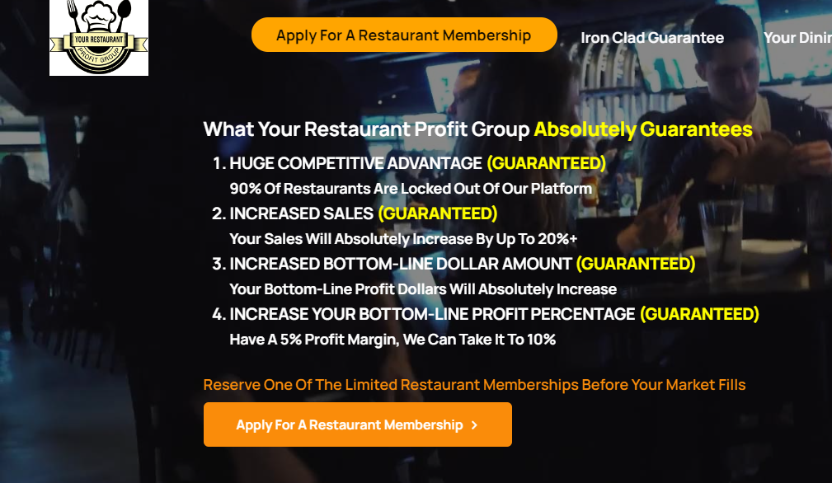

Please Apply Now As Markets Fill Fast
Thank You For Your Time Today
Notes:
Please apply now as I have mentioned a few times throughout this presentation there is absolutely zero risk and zero cost and even applying immediately still does not guarantee your restaurant will be chosen as markets fill fast as most, if not all, who view this presentation quickly apply. Please just select the state and city your restaurant is in to be taken to your GRP Restaurant Rescue Application.

